Slide 1
The Tequila Diet: Using Questionable Health Claims to Teach Undergraduates about Fake News
Alex Pfundt
Research & Instruction Librarian Coordinator of Information Literacy
Bryn Mawr College

Slide 2
Learning Outcomes
Student’s will be able to…
Understand that not all fake news is political, and that it is part of a greater epidemic of misinformation
Fact-check viral news stories by seeking out additional authoritative information sources

Slide 3

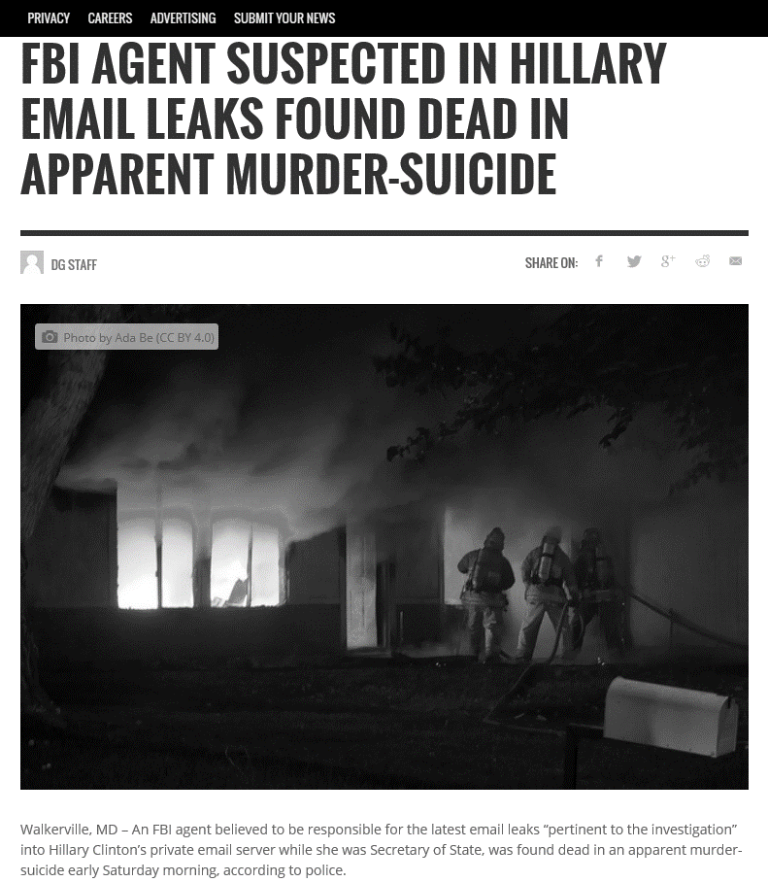
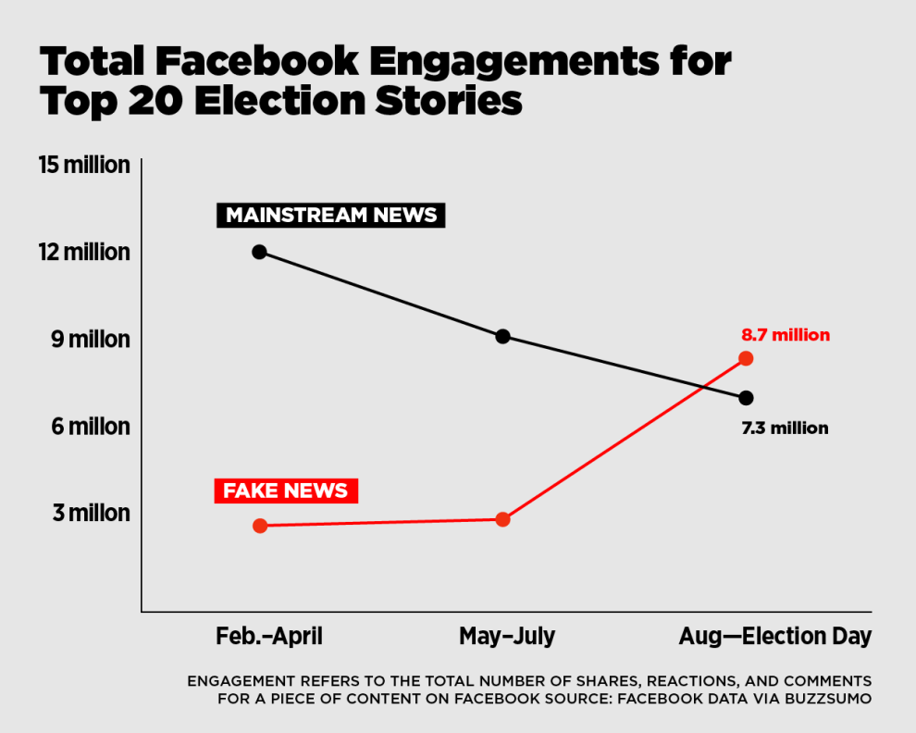
Curriculum
History of propaganda
Information overload
Statistics about news consumption on social media
Examples of fake news
Ad Tech
Foreign interference
Definitions of “authority”

Slide 4
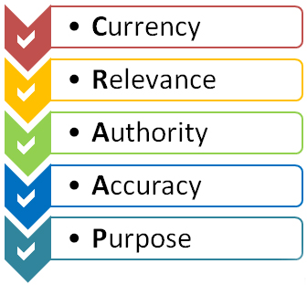
Why not teach the checklist?
Stanford History Education Group
Tested historians, professional fact-checkers, and undergraduates
Fact-checkers performed better by using lateral reading versus historians and undergraduates who read vertically (Wineburg & McGrew, 2017)
Source: http://scad.libguides.com/c.php?g=164805&p=1316087
Notes:
Wineburg, S. & McGrew, S. (2017). Lateral reading: Reading less and learning more when evaluating digital information. Retrieved from https://papers.ssrn.com/sol3/papers.cfm?abstract_id=3048994

Slide 5

Activity: Think Like a Fact-Checker
Students work in groups of 2-3
Read articles to identify the main claim the author is making
Look for sources that confirm or contradict the claim
Original sources referenced in the article
Who would could speak with authority on this topic?
Be ready to share!

Slide 6
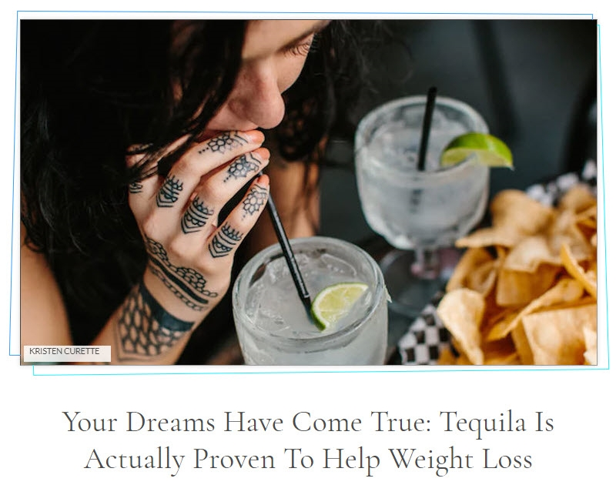
Claim #1
FALSE!
https://www.elitedaily.com/news/world/praise-lord-tequila-can-actually-aide-weight-loss

Slide 7
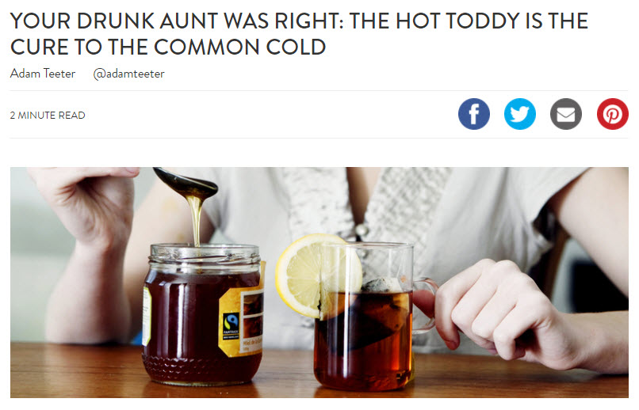
Claim #2
MOSTLY FALSE!
https://vinepair.com/wine-blog/drunk-aunt-right-hot-toddy-cure-common-cold/

Slide 8
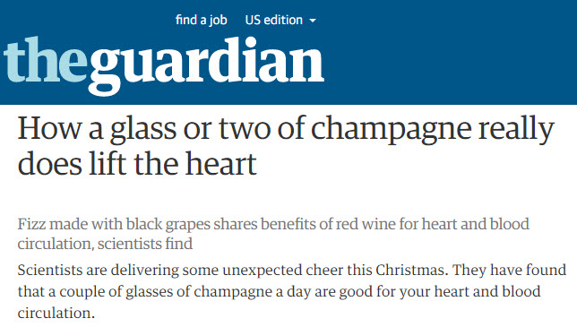
Claim #3
TRUE!
https://www.theguardian.com/lifeandstyle/2009/dec/13/champagne-heart

Slide 9

Discussion Prompts
What questions did you have after reading the article?
What was the process you went through to find additional sources?
How did you know whether or not to trust those sources?
What do you do when you encounter conflicting information?

Slide 10
THANK YOU!
Alex Pfundt
apfundt@brynmawr.edu

