Slide 1
Bias and Objectivity in Journalism
Eleanor Goldberg, Reference & Instruction Librarian
Liaison to Business, Computing, and Social Science
Delaware County Community College, Media, PA
egoldberg1@dccc.edu

Slide 2
Students’ expressed information need:
Facts
Not opinion
Unbiased information
Statistics

Slide 3
objectivity
bias
vs.
fact
interpretation
evidence
opinion

Slide 4
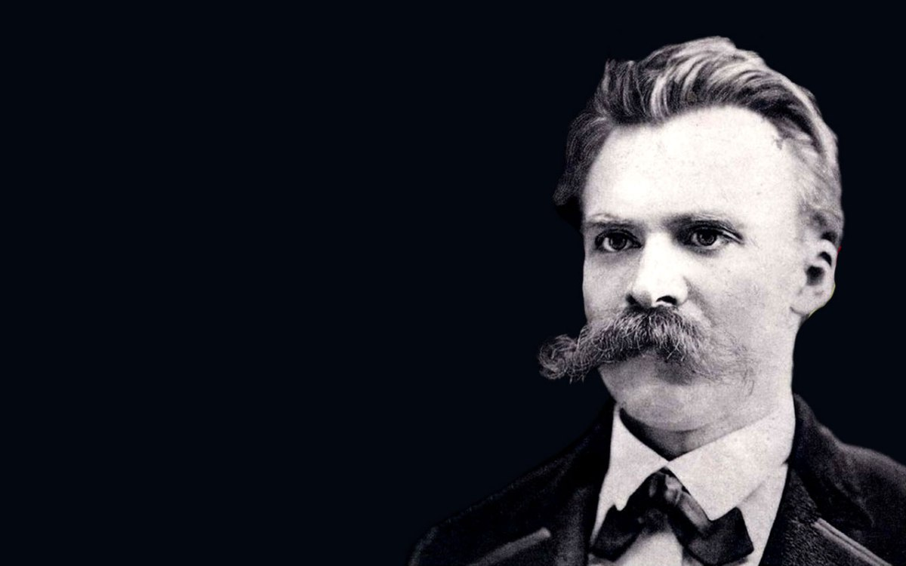
There are no facts,
only interpretations.
—Friedrich Nietzsche, 1887

Slide 5
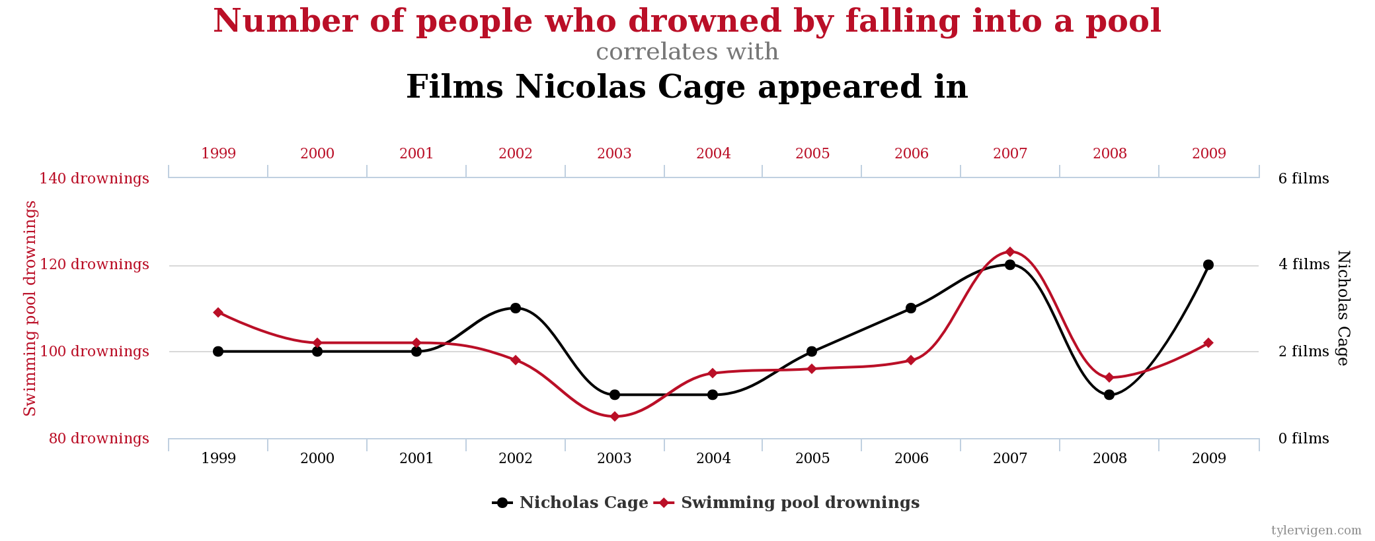
Data sources: Centers for Disease Control & Prevention and Internet Movie Database
Spurious Correlations: http://www.tylervigen.com/spurious-correlations

Slide 6
The purpose of journalism: to provide people with verified information they can use to make better decisions…a systematic process – a discipline of verification – that journalists use to find not just the facts, but also the “truth about the facts.”
—The American Press Institute

Slide 7
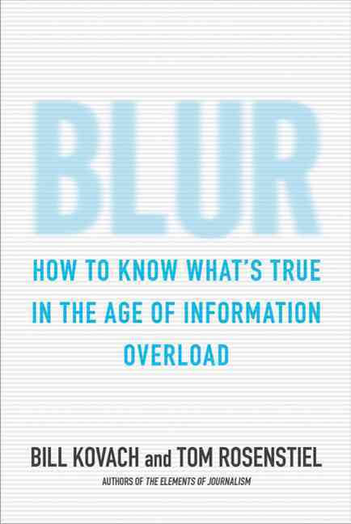
Blur: How to Know What’s True in the Age of Information Overload
by Bill Kovach and Tom Rosenstiel
Bloomsbury, 2011

Slide 8
Thank you.
Eleanor Goldberg
Reference & Instruction Librarian
Liaison to Business, Computing, and Social Science
Delaware County Community College, Media, PA
egoldberg1@dccc.edu

